Slide 1
Flow zoning

Slide 2
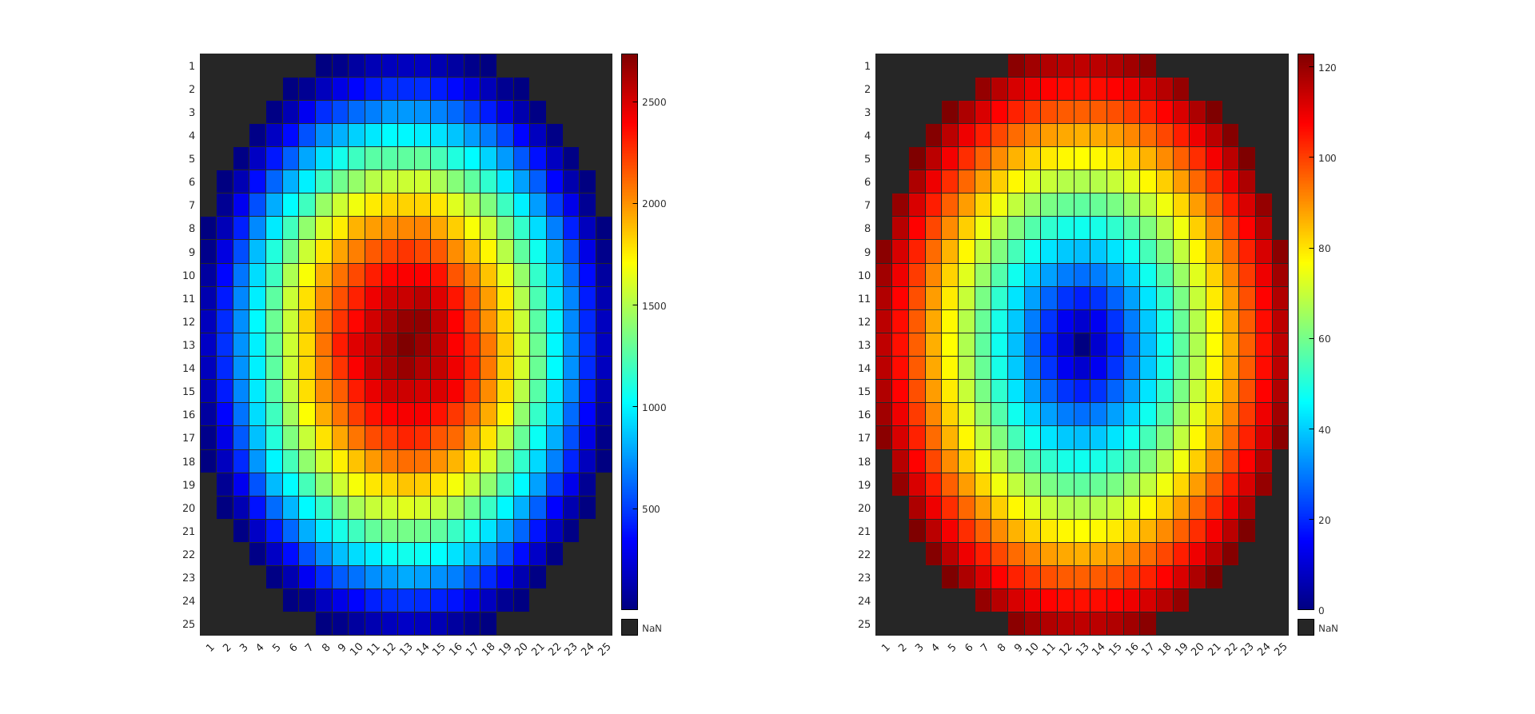
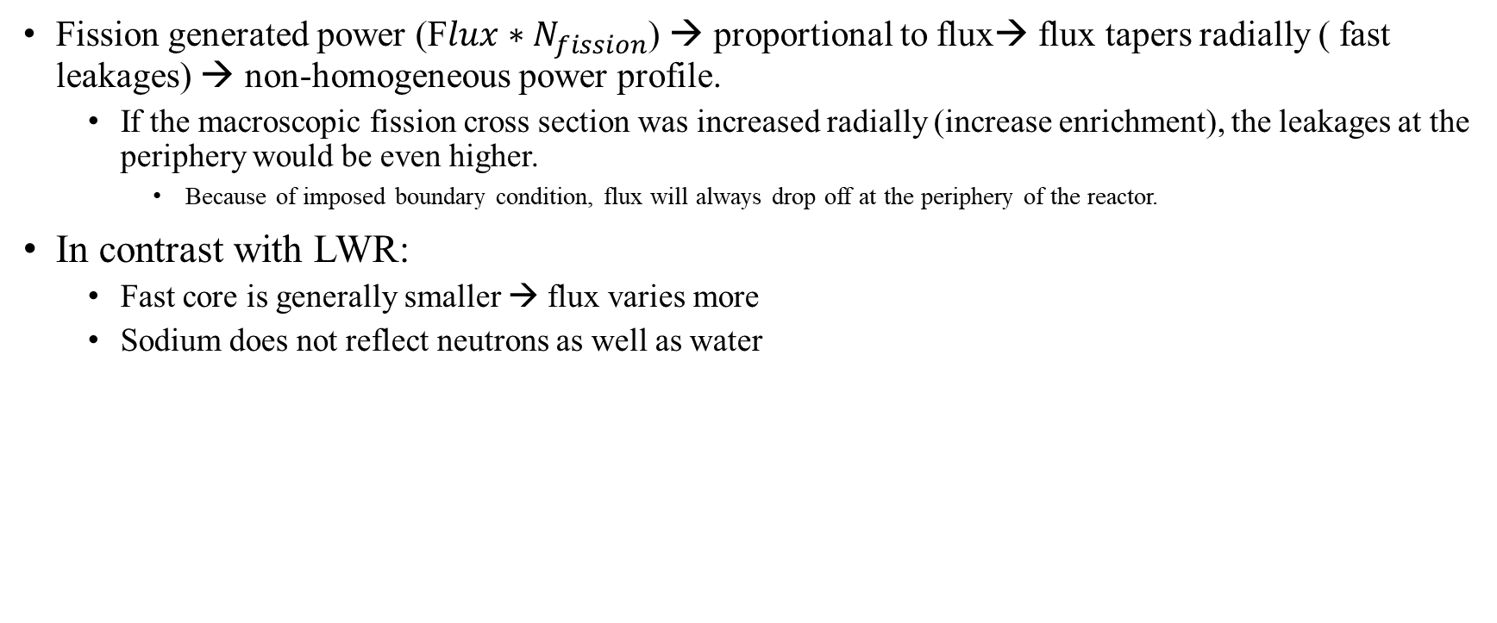
Why radial power distribution:
Fission generated power (F$lux∗N_{fission}$) → proportional to flux→ flux tapers radially ( fast leakages) → non-homogeneous power profile.
If the macroscopic fission cross section was increased radially (increase enrichment), the leakages at the periphery would be even higher.
Because of imposed boundary condition, flux will always drop off at the periphery of the reactor.
In contrast with LWR:
Fast core is generally smaller → flux varies more
Sodium does not reflect neutrons as well as water
From my thesis for sodium cooled microreactor

Slide 3
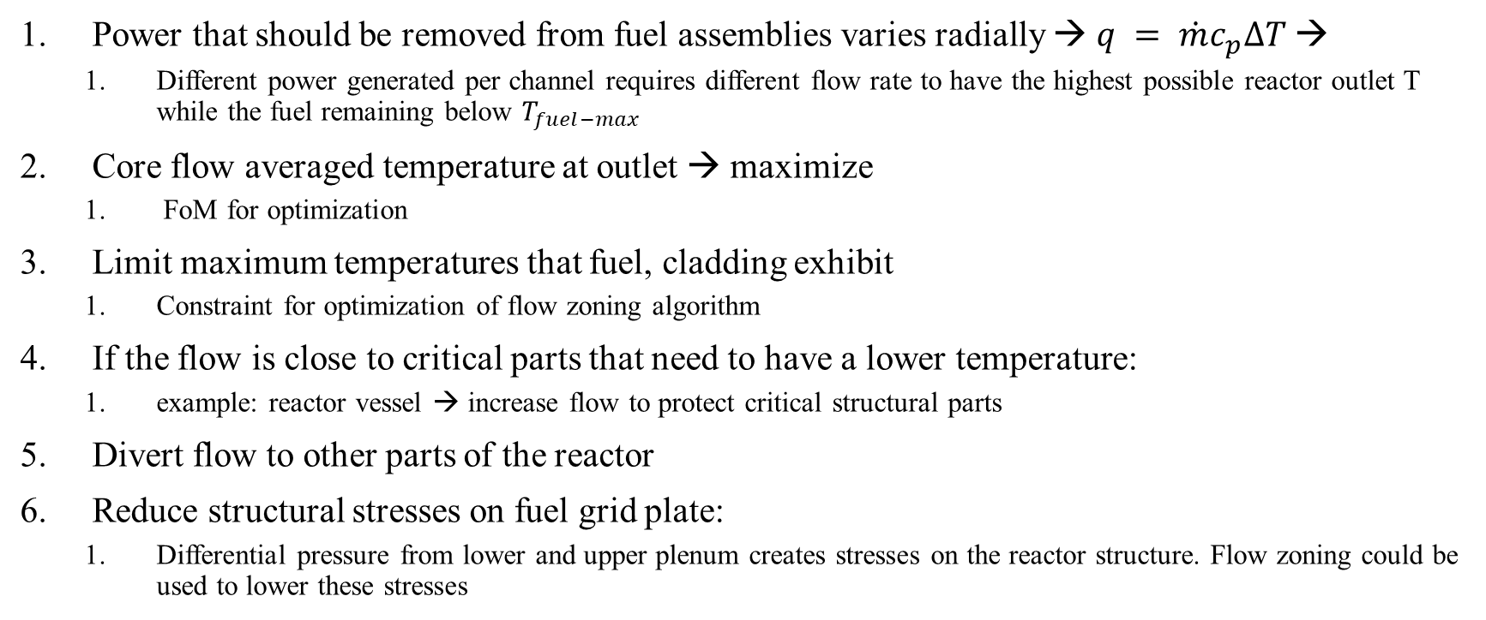
Which phenomena is flow-zoning mitigating:
Power that should be removed from fuel assemblies varies radially → $q = \dot{m}c_{p}∆T$→
Different power generated per channel requires different flow rate to have the highest possible reactor outlet T while the fuel remaining below $T_{fuel−max}$
Core flow averaged temperature at outlet → maximize
FoM for optimization
Limit maximum temperatures that fuel, cladding exhibit
Constraint for optimization of flow zoning algorithm
If the flow is close to critical parts that need to have a lower temperature:
example: reactor vessel → increase flow to protect critical structural parts
Divert flow to other parts of the reactor
Reduce structural stresses on fuel grid plate:
Differential pressure from lower and upper plenum creates stresses on the reactor structure. Flow zoning could be used to lower these stresses

Slide 4
What factors should be considered:
Power generation per channel
How power generation changes with BU/ time
What if power distribution remains the same but total power reduces? With the installed orifices would the flow distribution also remain the same without changing the orifices?
It depends!
If the power generation changes above the flow-zone “power levels” → variable orifice should be installed
What is flow velocity at orifices → cavitation? Thermal striping?
Pressure drop at channels might not be the same (different channel hydraulic diameter)
Flow regime:
If laminar hydraulic resistance does not depend on flow velocity
If turbulent however resistance does depend on flow velocity → tend to spread evenly the flow, compensate with higher orrifie resistance.
Ease of installation of orifices, cost
Orifice design should be modular: should be able to be stacked on top of each other to create the desired pressure drop
How the flow enters the lower plenum:
Downcomer?
Mixing plate?

Slide 5
How is flow zoning done:
Goal: vary outlet T radially
To do so: vary flow → vary pressure drop per flow zone
Only solution is to add extra hydraulic resistance to the zones that should have a smaller flow
Another impractical solution would be to have individual feeding systems (pumps) for each flow zone.
This resistance can either be constant throughout the lifetime of the reactor, or change as a function of BU.
What if core is shuffled:
If core is shuffled → radial power distribution changes
Either implement flow zoning algorithm described below to optimize for outlet T for core’s lifetime, with constant orifice resistance
Or use variable orifices

Slide 6
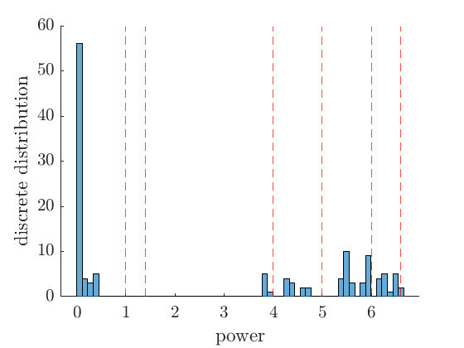
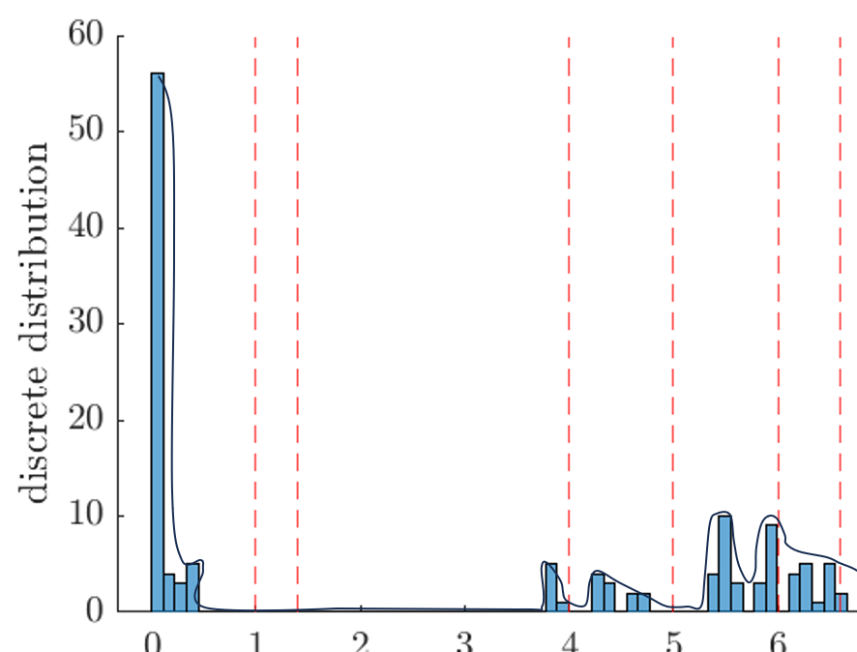
Flow zoning algorithm to maximize outlet temp:
Problem statement: position of cuts is what? So that core averaged outlet T is maximized while fuel T below limits
Optimization parameters
FoM
constraints
Discrete optimization problem → harder to solve. It could be approximated by using the equivalent “Continuous problem”
Take power values and create histogram:
From discrete distribution function, can analytically approximate its shape:
Now we have an analytical description of the distribution function of the radial power density.

Slide 7
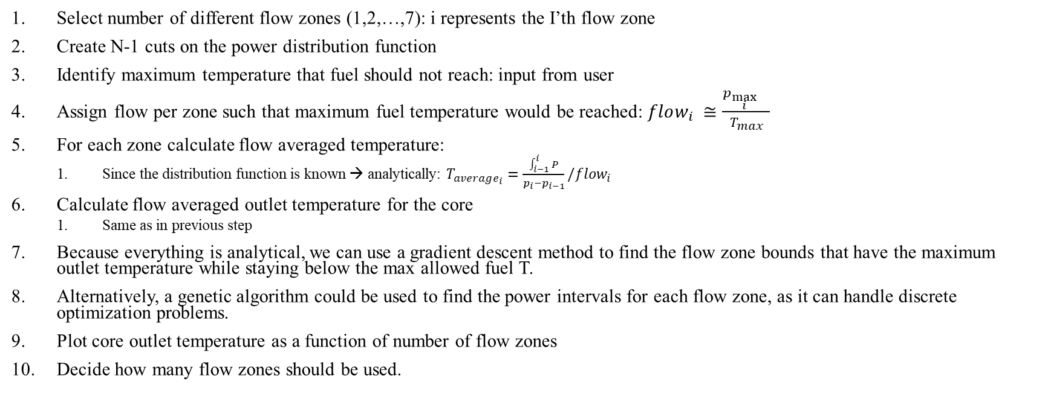
Algorithm continued:
Select number of different flow zones (1,2,…,7): i represents the I’th flow zone
Create N-1 cuts on the power distribution function
Identify maximum temperature that fuel should not reach: input from user
Assign flow per zone such that maximum fuel temperature would be reached: $flow_{i} ≅\frac{p_{\max_{i}{}}}{T_{max}}$
For each zone calculate flow averaged temperature:
Since the distribution function is known → analytically: $T_{average_{i}}=\frac{\int_{i−1}^{i}{P}}{p_{i}−p_{i−1}}/flow_{i}$
Calculate flow averaged outlet temperature for the core
Same as in previous step
Because everything is analytical, we can use a gradient descent method to find the flow zone bounds that have the maximum outlet temperature while staying below the max allowed fuel T.
Alternatively, a genetic algorithm could be used to find the power intervals for each flow zone, as it can handle discrete optimization problems.
Plot core outlet temperature as a function of number of flow zones
Decide how many flow zones should be used.

Slide 8
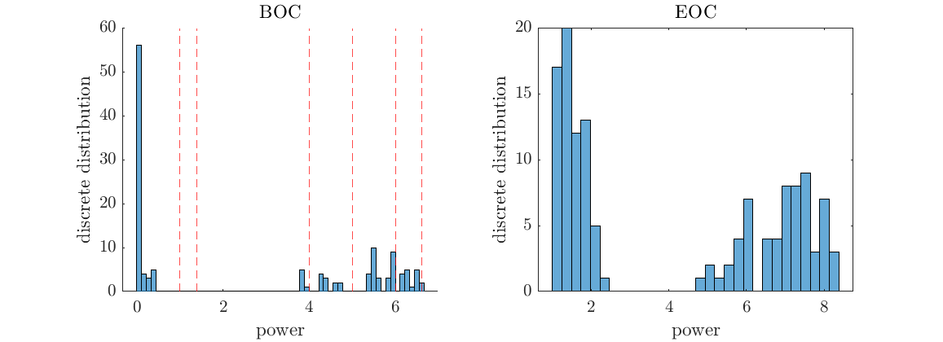
If we have multiple power distribution functions (BOC, EOC, etc.) :
Distribution function for each snap-shot (previous algorithm)
Conduct same analysis as before, but with common bounds for multiple snap-shots
FoM: Average outlet temperature from all snap-shots

